Slide 1
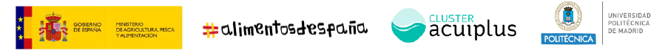




Proyecto MedAID
Bernardo Basurco (CIHEAM Zaragoza), Dolors Furones (IRTA) & Cristóbal Aguilera (IRTA)
El futuro de la Economía Circular y la Acuicultura Sostenible. Madrid, 18 nov 2021

Slide 2
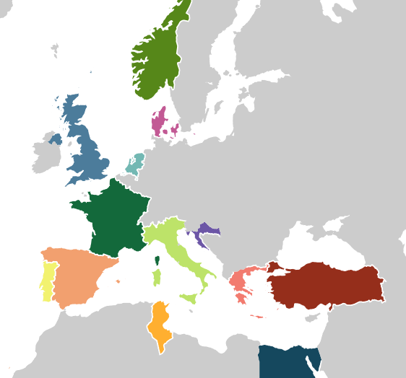











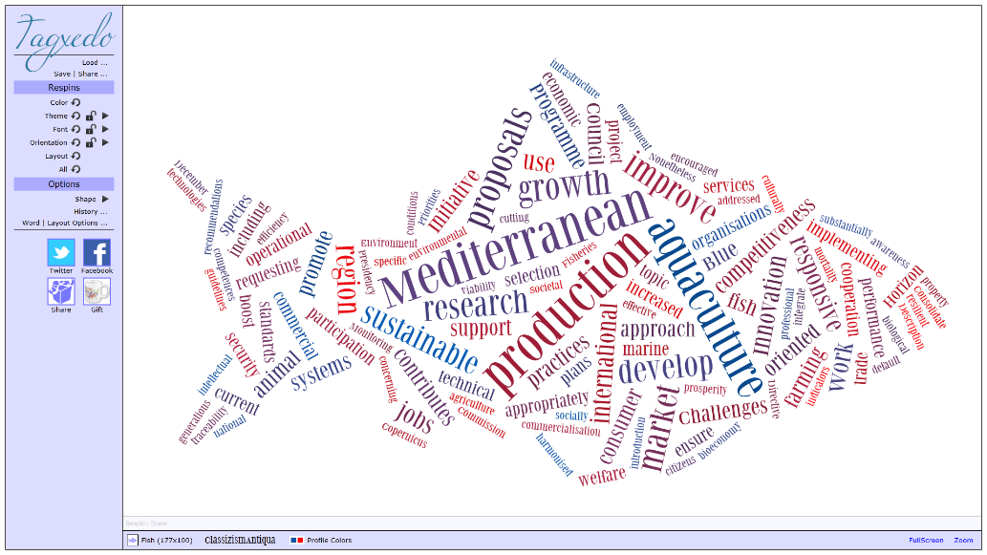


























MedAID at glance
Topic SFS-23-2016: Improving the technical performance of the Mediterranean aquaculture
13 Countries
24 Research Institutions
8 companies
2 International organizations
EU fish diseases labs
May 2017-Nov 2021 (Covid)
7 million €
RIA (Research and Innovation Action)
Increase the overall competitiveness and sustainability of the Mediterranean marine fish-farming sector, throughout the whole value chain.
El futuro de la Economía Circular y la Acuicultura Sostenible. Madrid, 18 nov 2021

Slide 3
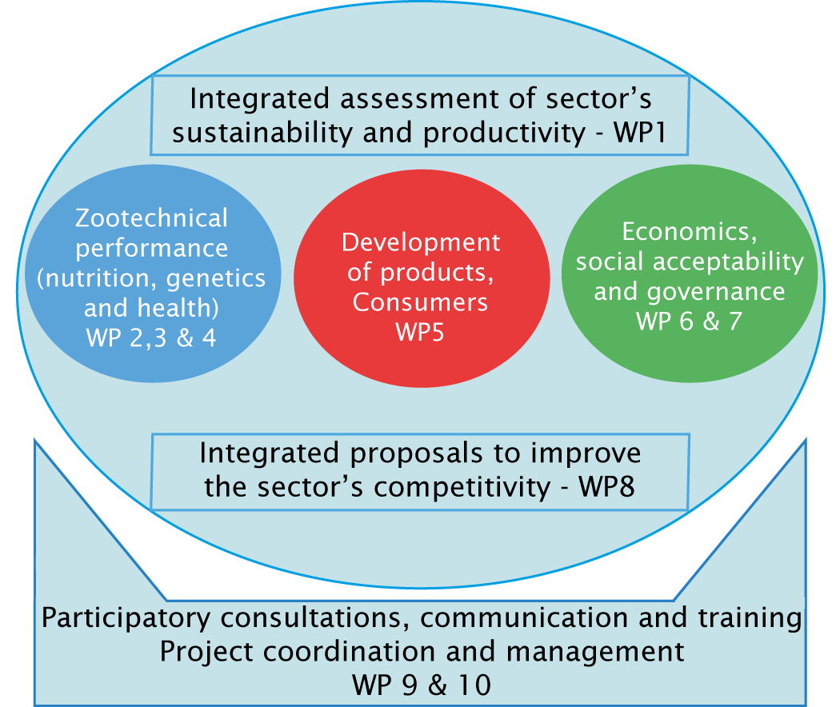
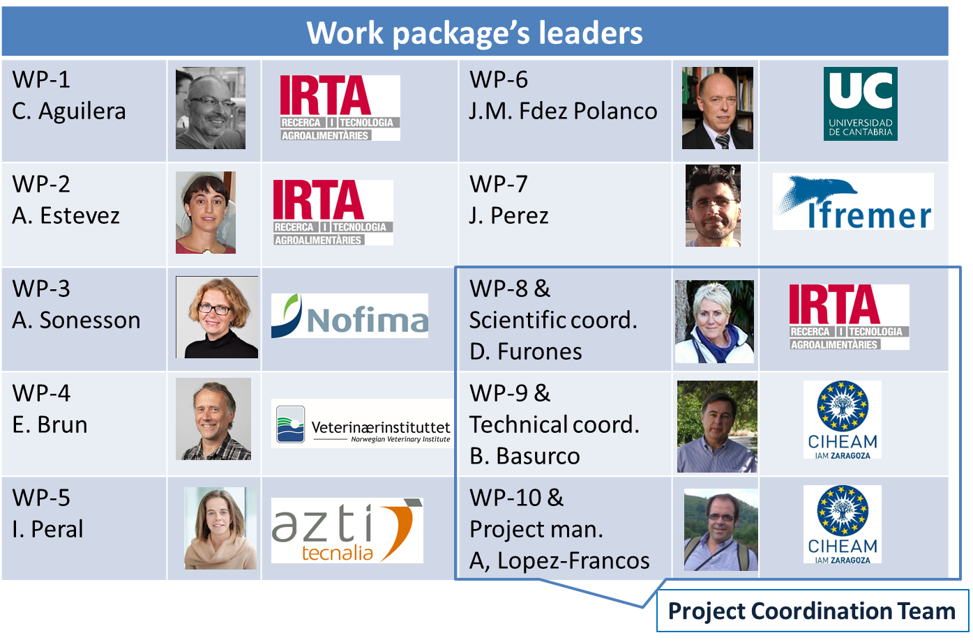
MedAID structure
El futuro de la Economía Circular y la Acuicultura Sostenible. Madrid, 18 nov 2021

Slide 4





MedAID outputs & impacts
Publications
Manuals
Webinars
Recommendations
Trainning
courses
Software platform
986 tweets
1070 followers
1.65 M impacts
78
820 posts
802 followers
21350 impressions
2
2
460 posts
125 followers
42
8
30 videos
450 reproductions
8
20480 users
32230 sessions
72360 visits
El futuro de la Economía Circular y la Acuicultura Sostenible. Madrid, 18 nov 2021

Slide 5




MedAID results on production and processing
Improving Zootechnical Performance
Larval and juvenile development: Tª, Protein/Lipid level water flows and swimming training
Ongrowing: adapted feeding (Tº, stress events, frequency), FM/FO levels, ecoadapted diets, functional feeds…
Genetics and breeding
Development of SNP chip seabream/seabass and testing for:
quality production traits characterisation, determining population structure and genetic variability, GxE analysis…
Phenotyping: validating Distell meter for lipid % in fillets
Health management and diseases and fish welfare
Pathogens risk assessment and scoring system,
Lab diagnostic capacities and techniques harmonisation (VNN), capacity building
Development and Testing new vaccine (VLP tech)
Product development, market and consumer assessment
Consumer studies and segmentation
New product design: consumers surveys, screening of ideas with stakeholders
Prototyping of selected products: technical characterisation, real production, market validation (tasting, packaging, attributes preferences…)
El futuro de la Economía Circular y la Acuicultura Sostenible. Madrid, 18 nov 2021

Slide 6




MedAID results on economics, market, industry…
Economics and markets
Analysis of firms production and productivity, economic optimization, impact/sensibility of technical improvements,
Market dynamics and equilibrium (offer-demand), mass media influence and sector communication
Social acceptability and governance
Social acceptability in Med aquaculture - concept and factors influencing
Methodological framework to foster social acceptability of aquaculture development
Pan Mediterranean survey and 3 local case studies
Industry holistic asessment
Pan Mediterranean survey and characterisation of fish farming systems. KPI identification, relation with husbandry practices, Life Cycle analysis
Development of a monitoring and benchmarking application
Stakeholder engagement, capacity building, dissemination
Dialogue and feedback: workshops, farm surveys, webinars, Final Event
Training: face to face courses and on-line modules
Outreach: Web, SSMM, publications, presentations…
El futuro de la Economía Circular y la Acuicultura Sostenible. Madrid, 18 nov 2021

Slide 7
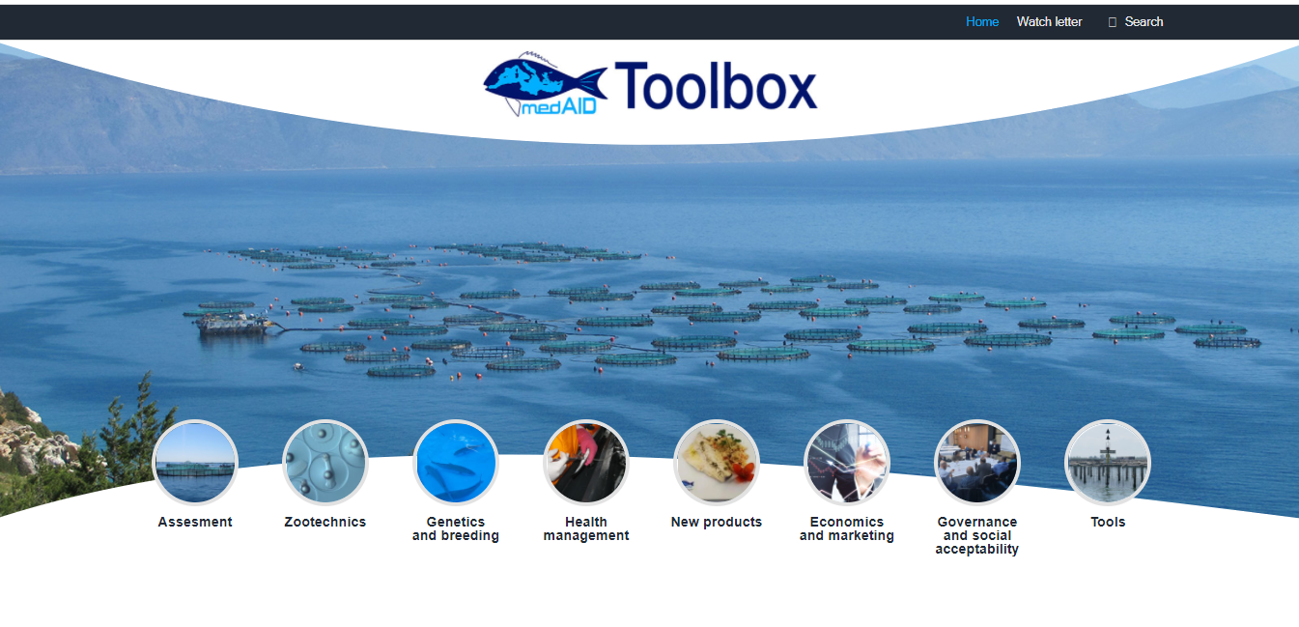


MedAID Toolbox
Useful management system to provide project results, formation, guides and recommendations to stakeholders about the components needed to consider a successful sustainable aquaculture development.
www.medaid-toolbox.eu/
Toolbox Structure
Adaptable: help users to understand
Easy assist with project results
Search by KPIs and keywords
Search by documents and categories
Provide access to guiding information
Tools
MedAID SMP Benchmarking
Economics tools
Watch letter
Other project tools
El futuro de la Economía Circular y la Acuicultura Sostenible. Madrid, 18 nov 2021

Slide 8
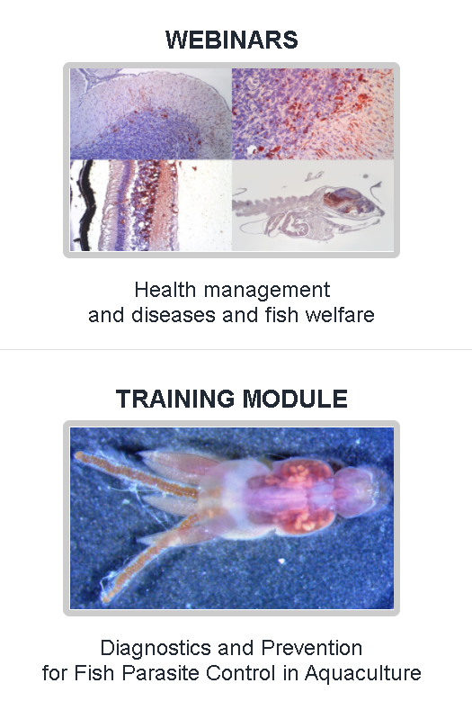
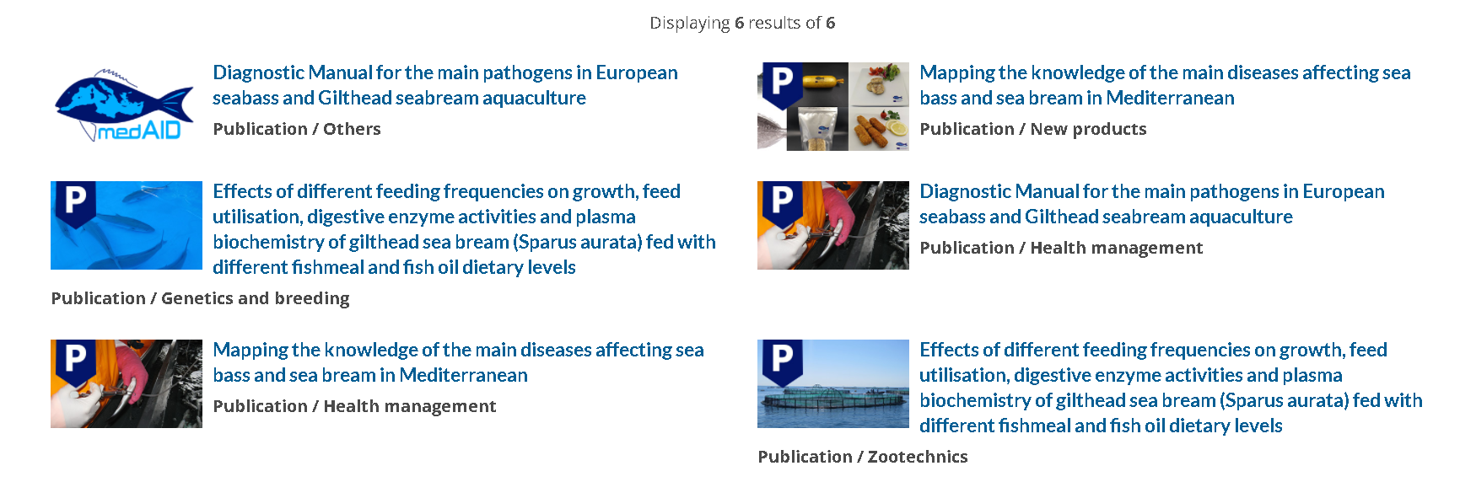
MedAID Toolbox in a nutshell gathering...
The MedAID Toolbox gathers a large number of deliverables, publications, guides, manuals, recommendations, software, case studies and other resources, organised in thematic modules. It has been created to provide aquaculture owners, managers, scientist, policymakers and other stakeholders easy access to outputs from MedAID.
El futuro de la Economía Circular y la Acuicultura Sostenible. Madrid, 18 nov 2021

Slide 9

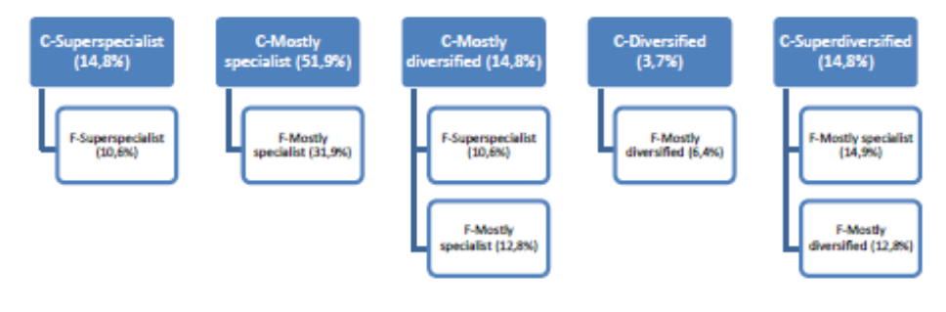





MedAID Benchmarking tool
To help us to understand differences between facilities
Based in annual production and species differentiation
To help us to auto-evaluate as a company level
To help us in a process of benchmarking in general and in a particular approach by facilities
To facilitate us some potential improvements based on the average of the sector and following MedAID recommendations
Data will be processed anonymously and comparisons of each user will be made with the industry average or similar facilities
El futuro de la Economía Circular y la Acuicultura Sostenible. Madrid, 18 nov 2021

Slide 10
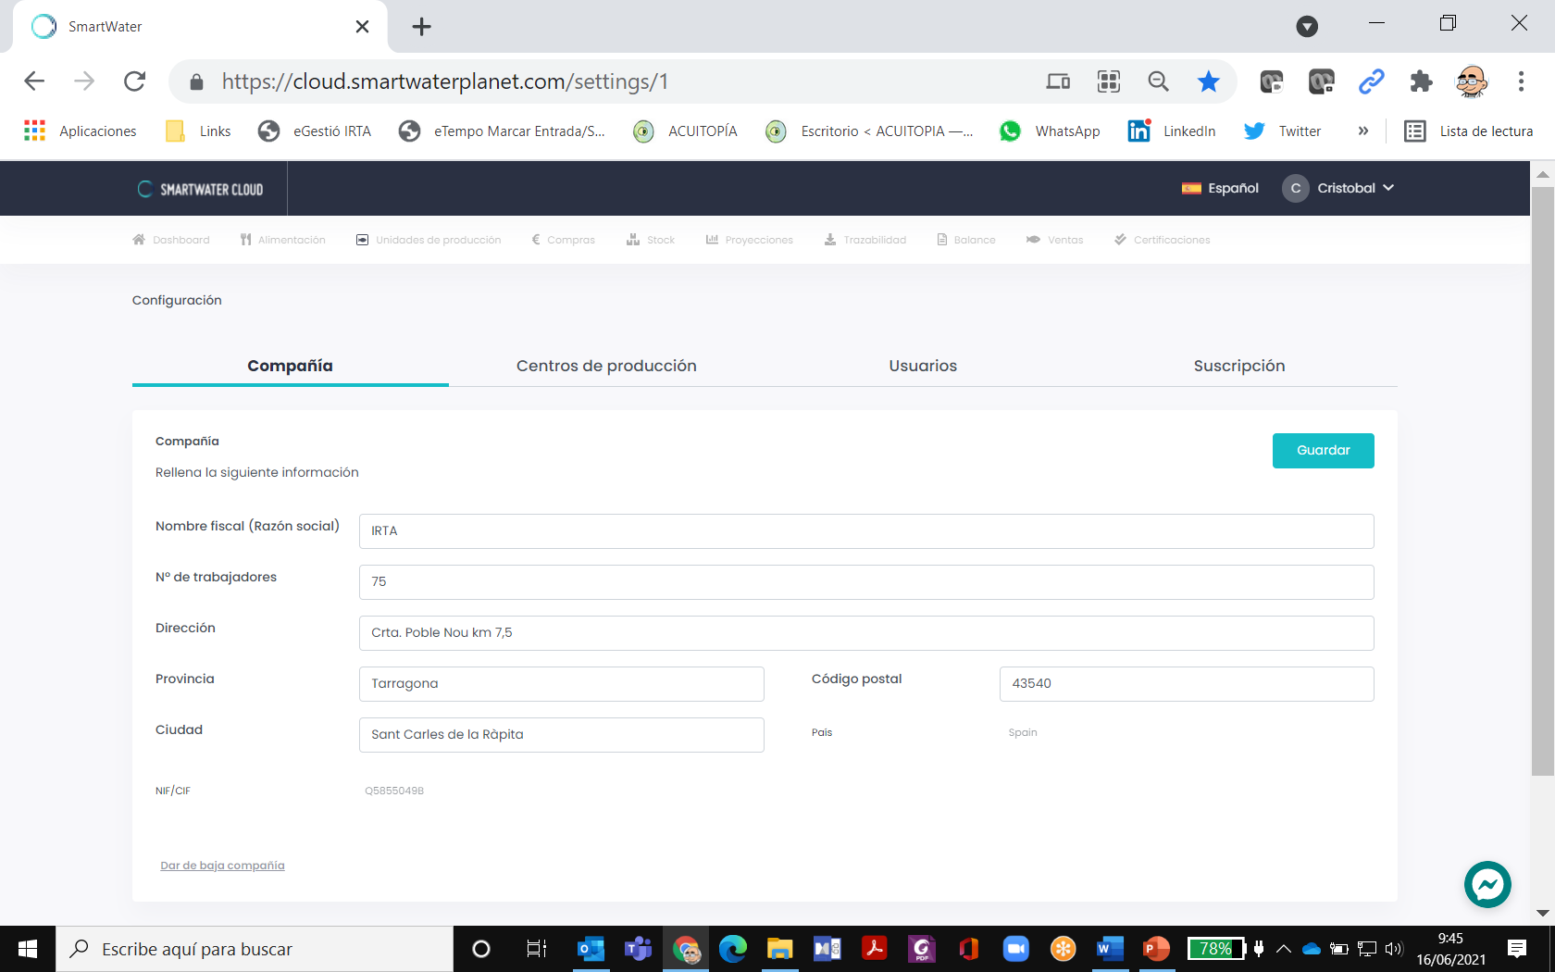
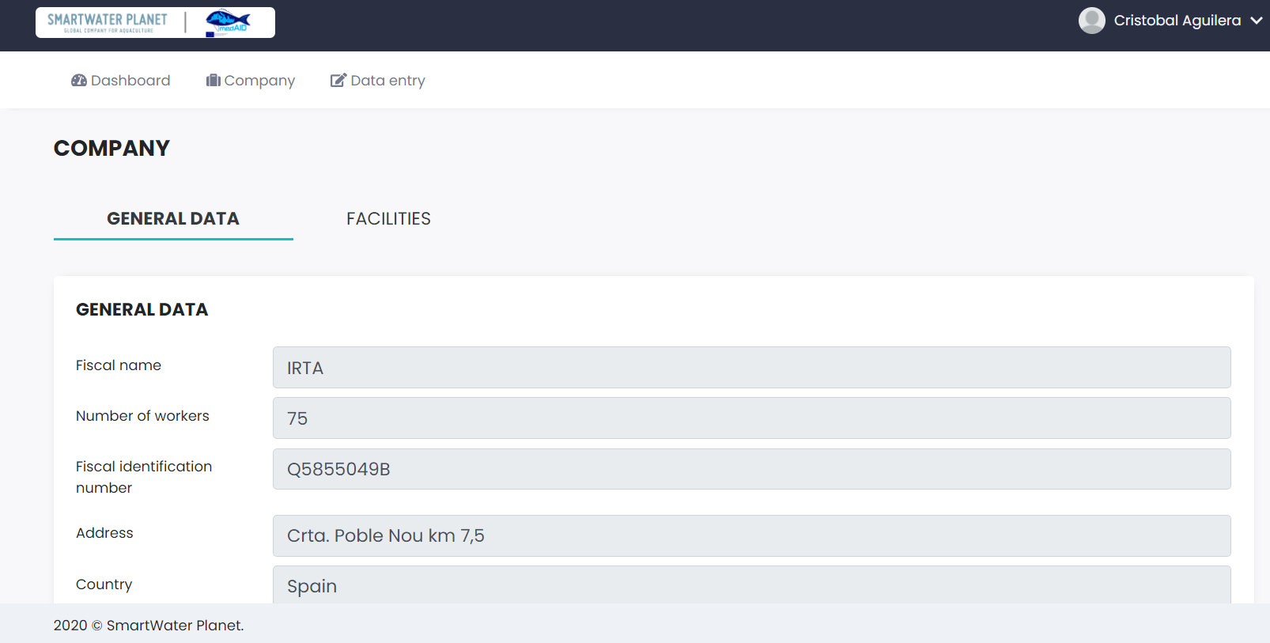
MedAID at glance
https://cloud.smartwaterplanet.com/settings/1
https://benchmarking.smartwaterplanet.com/company
El futuro de la Economía Circular y la Acuicultura Sostenible. Madrid, 18 nov 2021

Slide 11
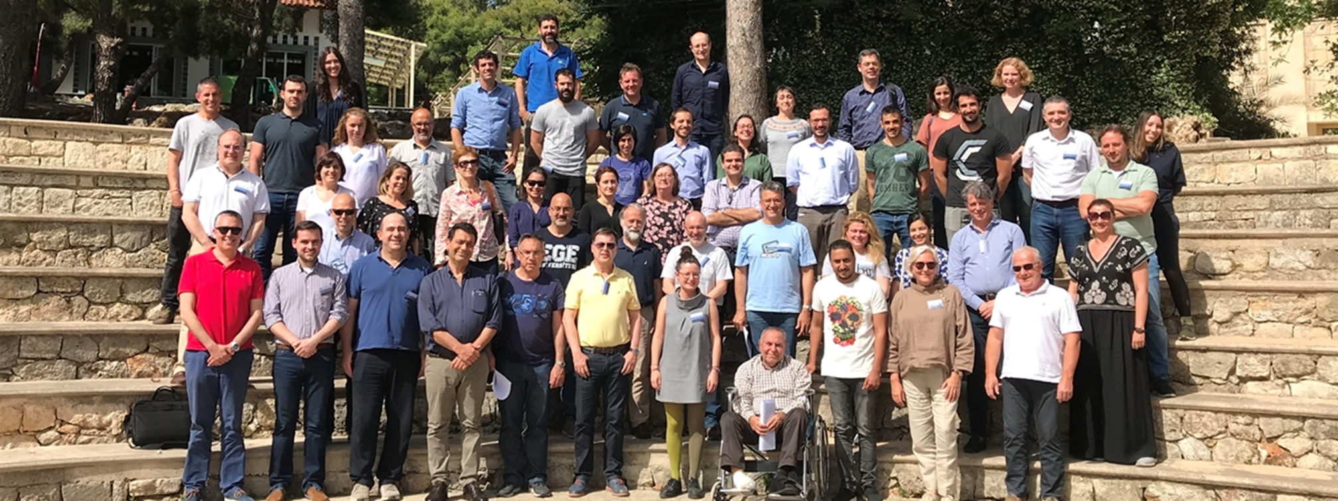
MedAID Team: many thanks
El futuro de la Economía Circular y la Acuicultura Sostenible. Madrid, 18 nov 2021

