Slide 1
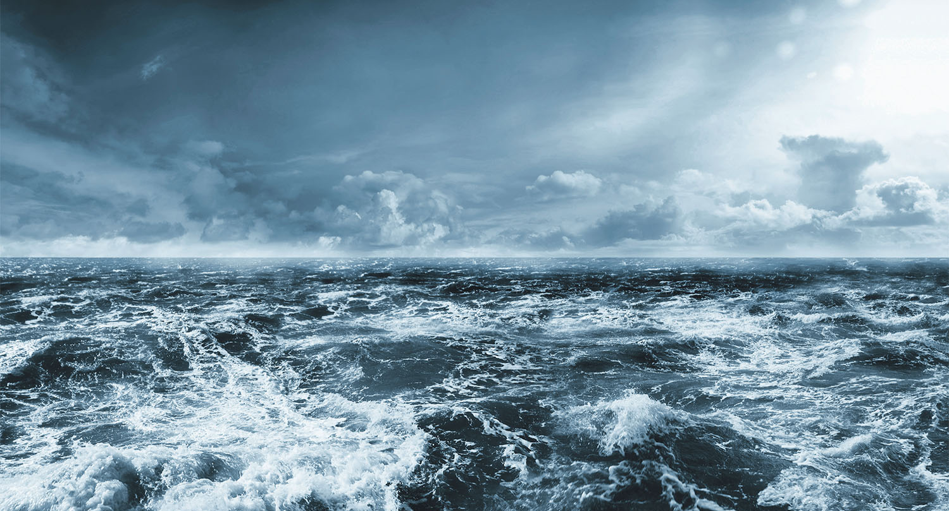
Working towards circular business models in Mørenot aquaculture

Slide 2

Mørenot IN BRIEF
Mørenot is a leading provider of solutions to the global fishing-, aquaculture-, and seismic industries.
781
28
11
EMPLOYEES
LOCATIONS
COUNTRIES
1.243
113
8%
REVENUE
(M NOK)
Rec. EBITDA
Yearly growth
2016-2020

Slide 3
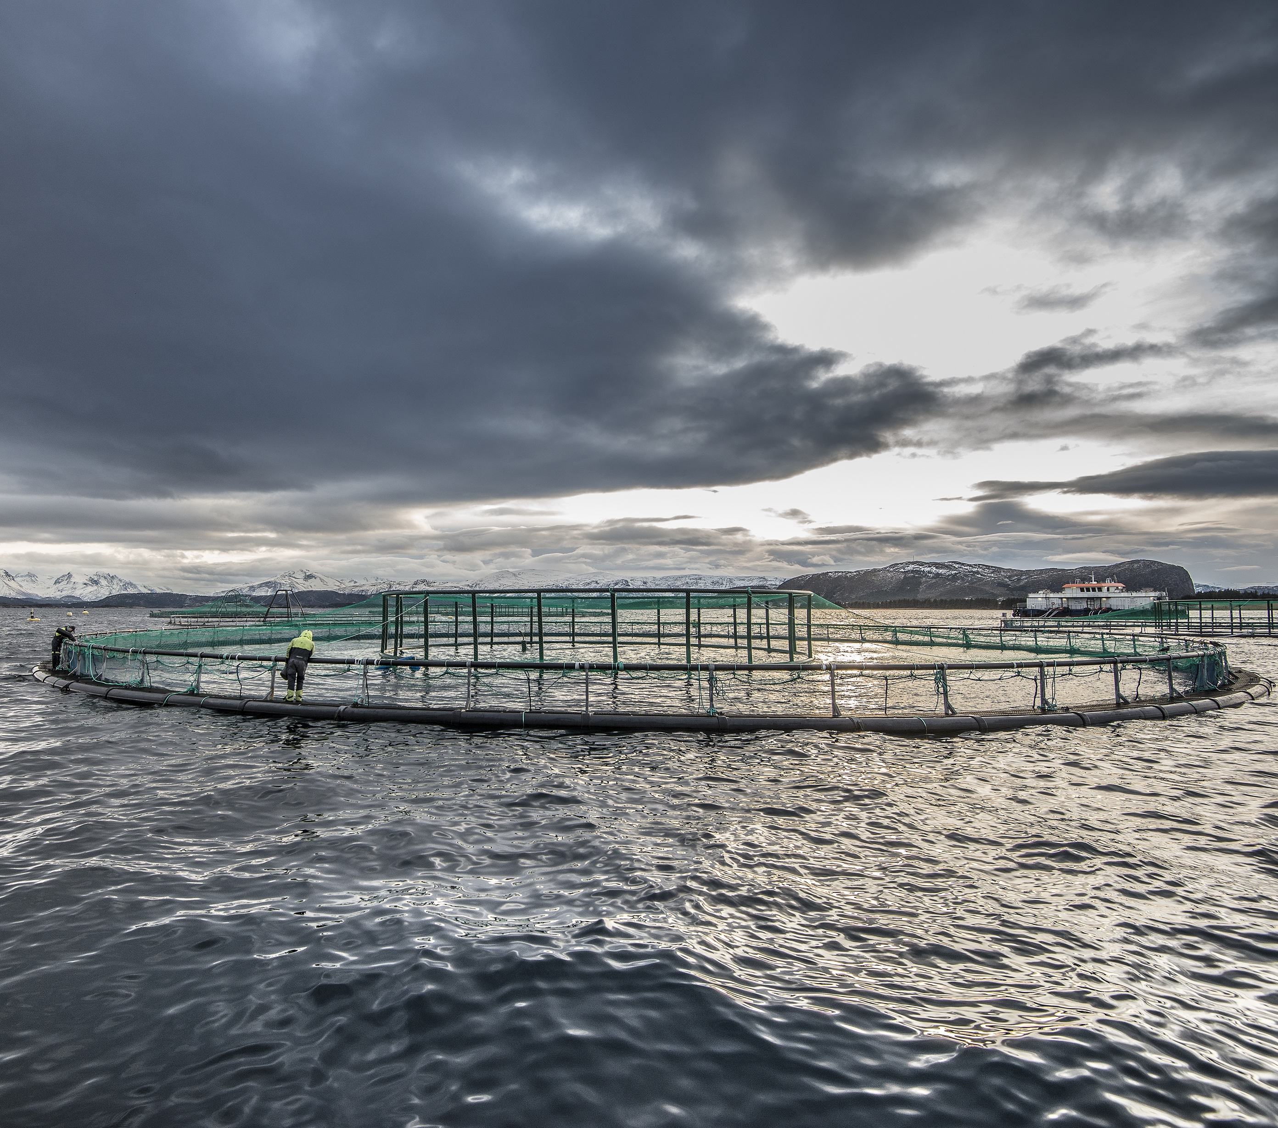
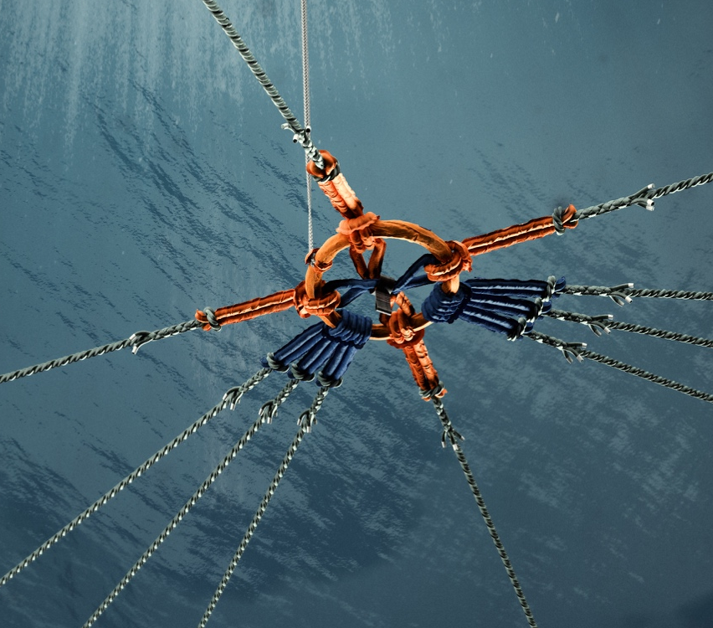
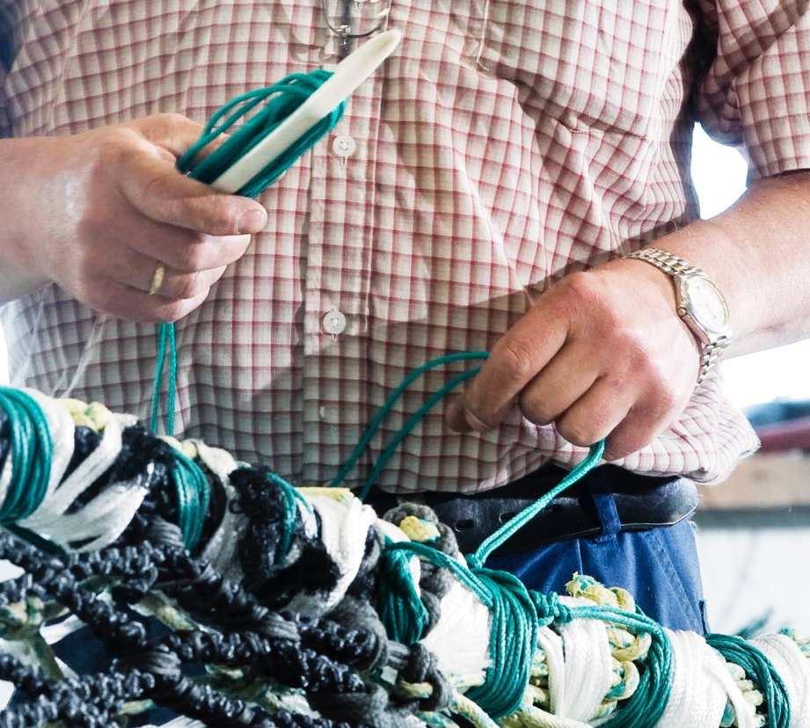
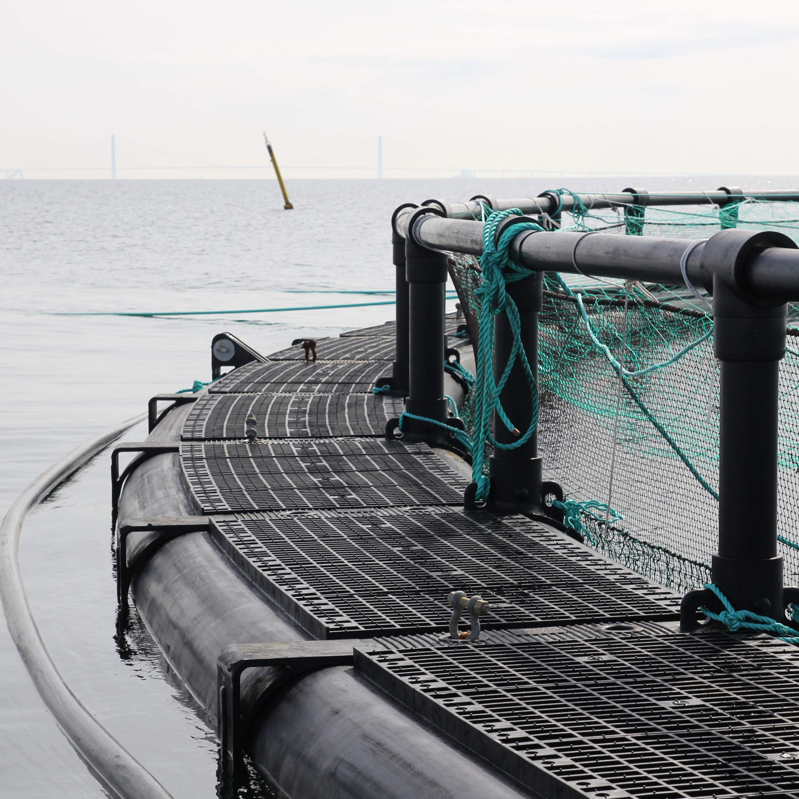
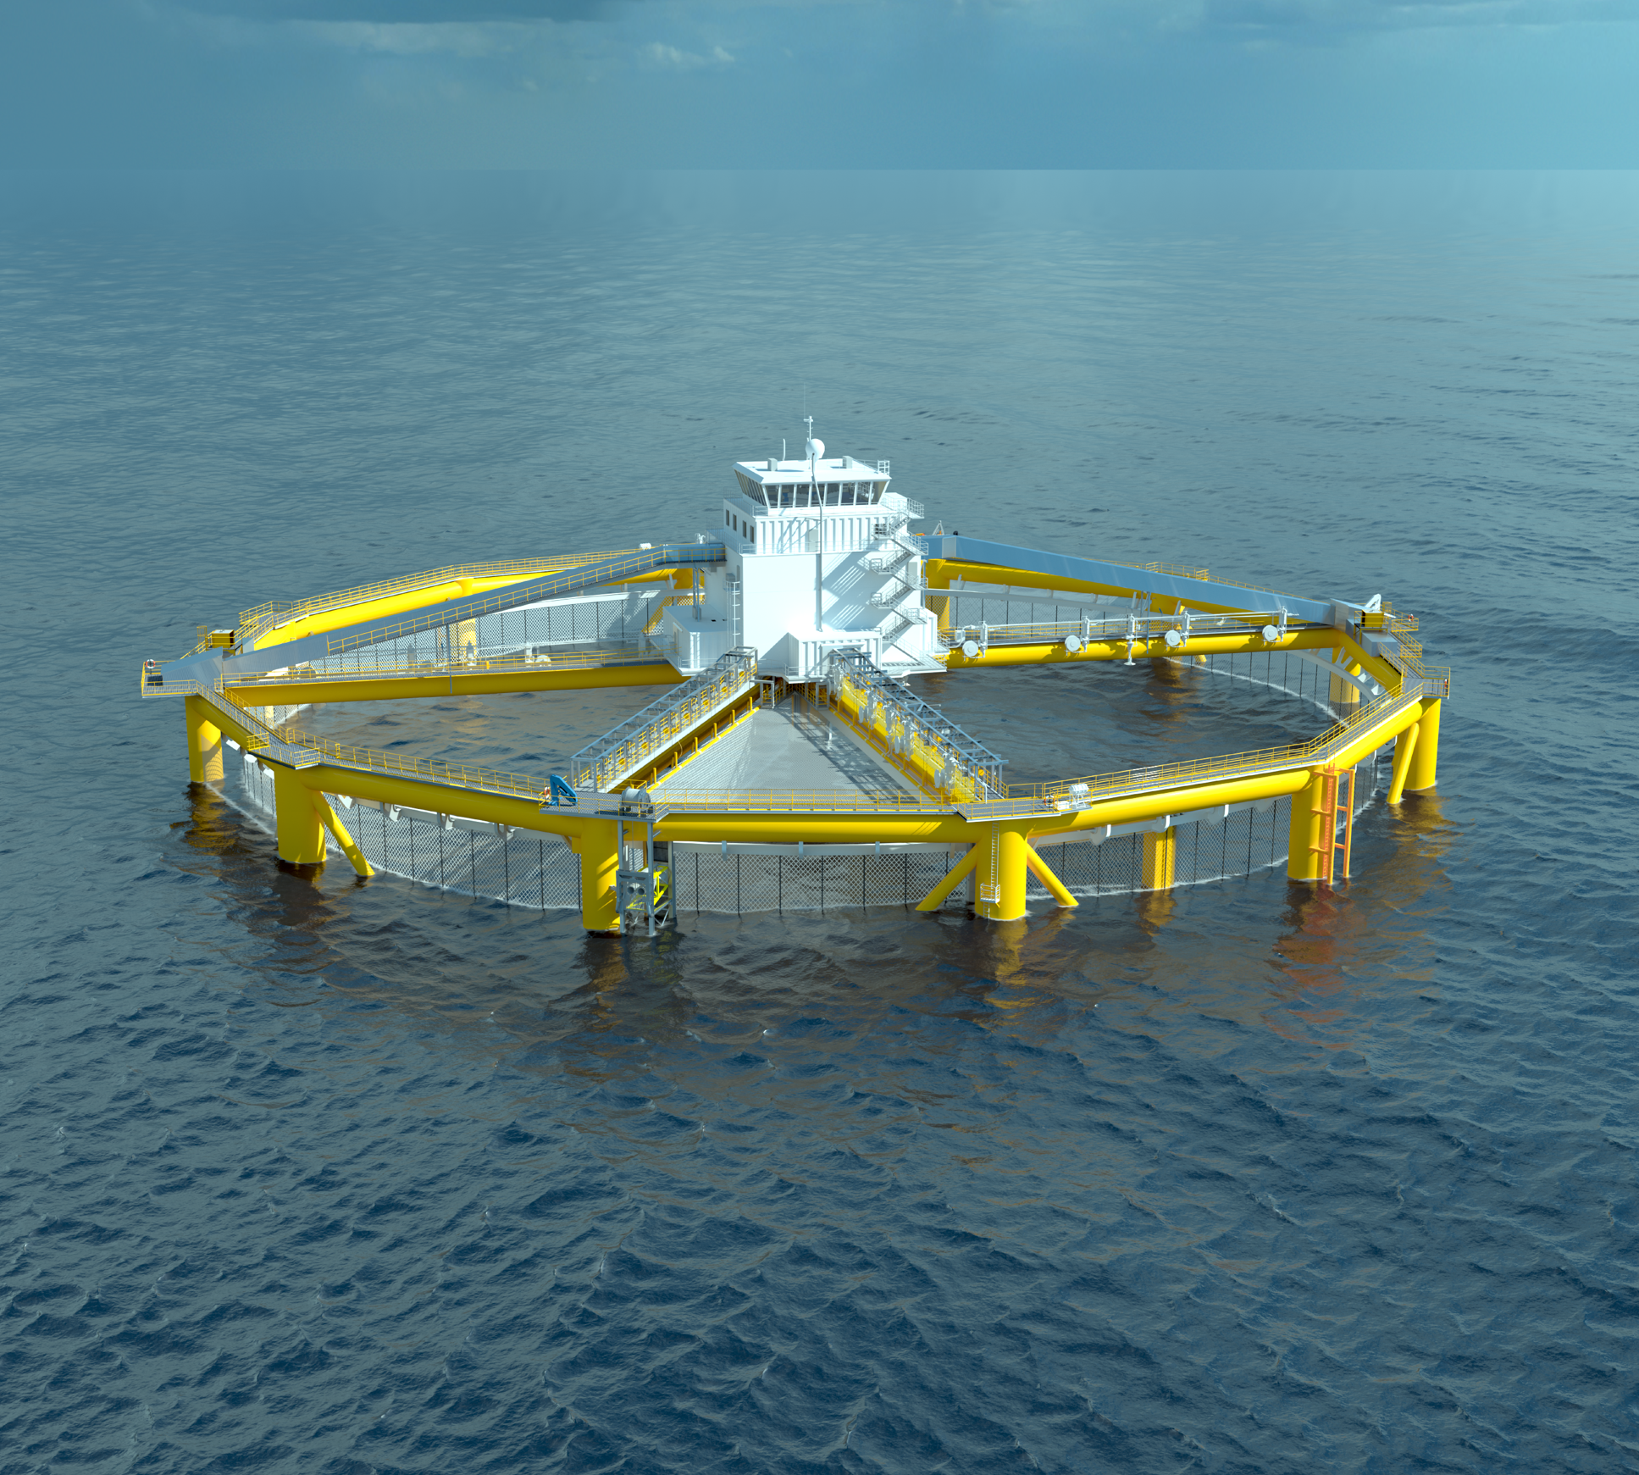
MAIN segments: Mørenot Aquaculture
Special products
NETS
mooring
Service
cages
High performance aquaculture nets and netting.
MNA uses only high quality filament.
Flexilink® - patented mooring solution made by fibers.
A complete range of long lasting mooring equipment.
Complete service offering for nets including washing, disinfecting, testing, repairs and antifouling.
EXTREME fish farm cages in HDPE for any kind of fish farm.
R&D projects such as
Arctic Ocean Farming and
Ocean Farming (OF1).

Slide 4


VISION
MISSION
To ensure that the oceans can feed generations to come
To create solutions to sustainably harvest food from the sea

Slide 5









ESG FOCUS AREAS
Attractive employer with a sustainable mindset
Resource efficient production and circularity
Supply chain ethics and transparency
Sustainable product offering
MØRENOT WANTS TO CONTRIBUTE TO THE UN’S SUSTAINABLE DEVELOPMENT GOALS
17.11.2021
5

Slide 6
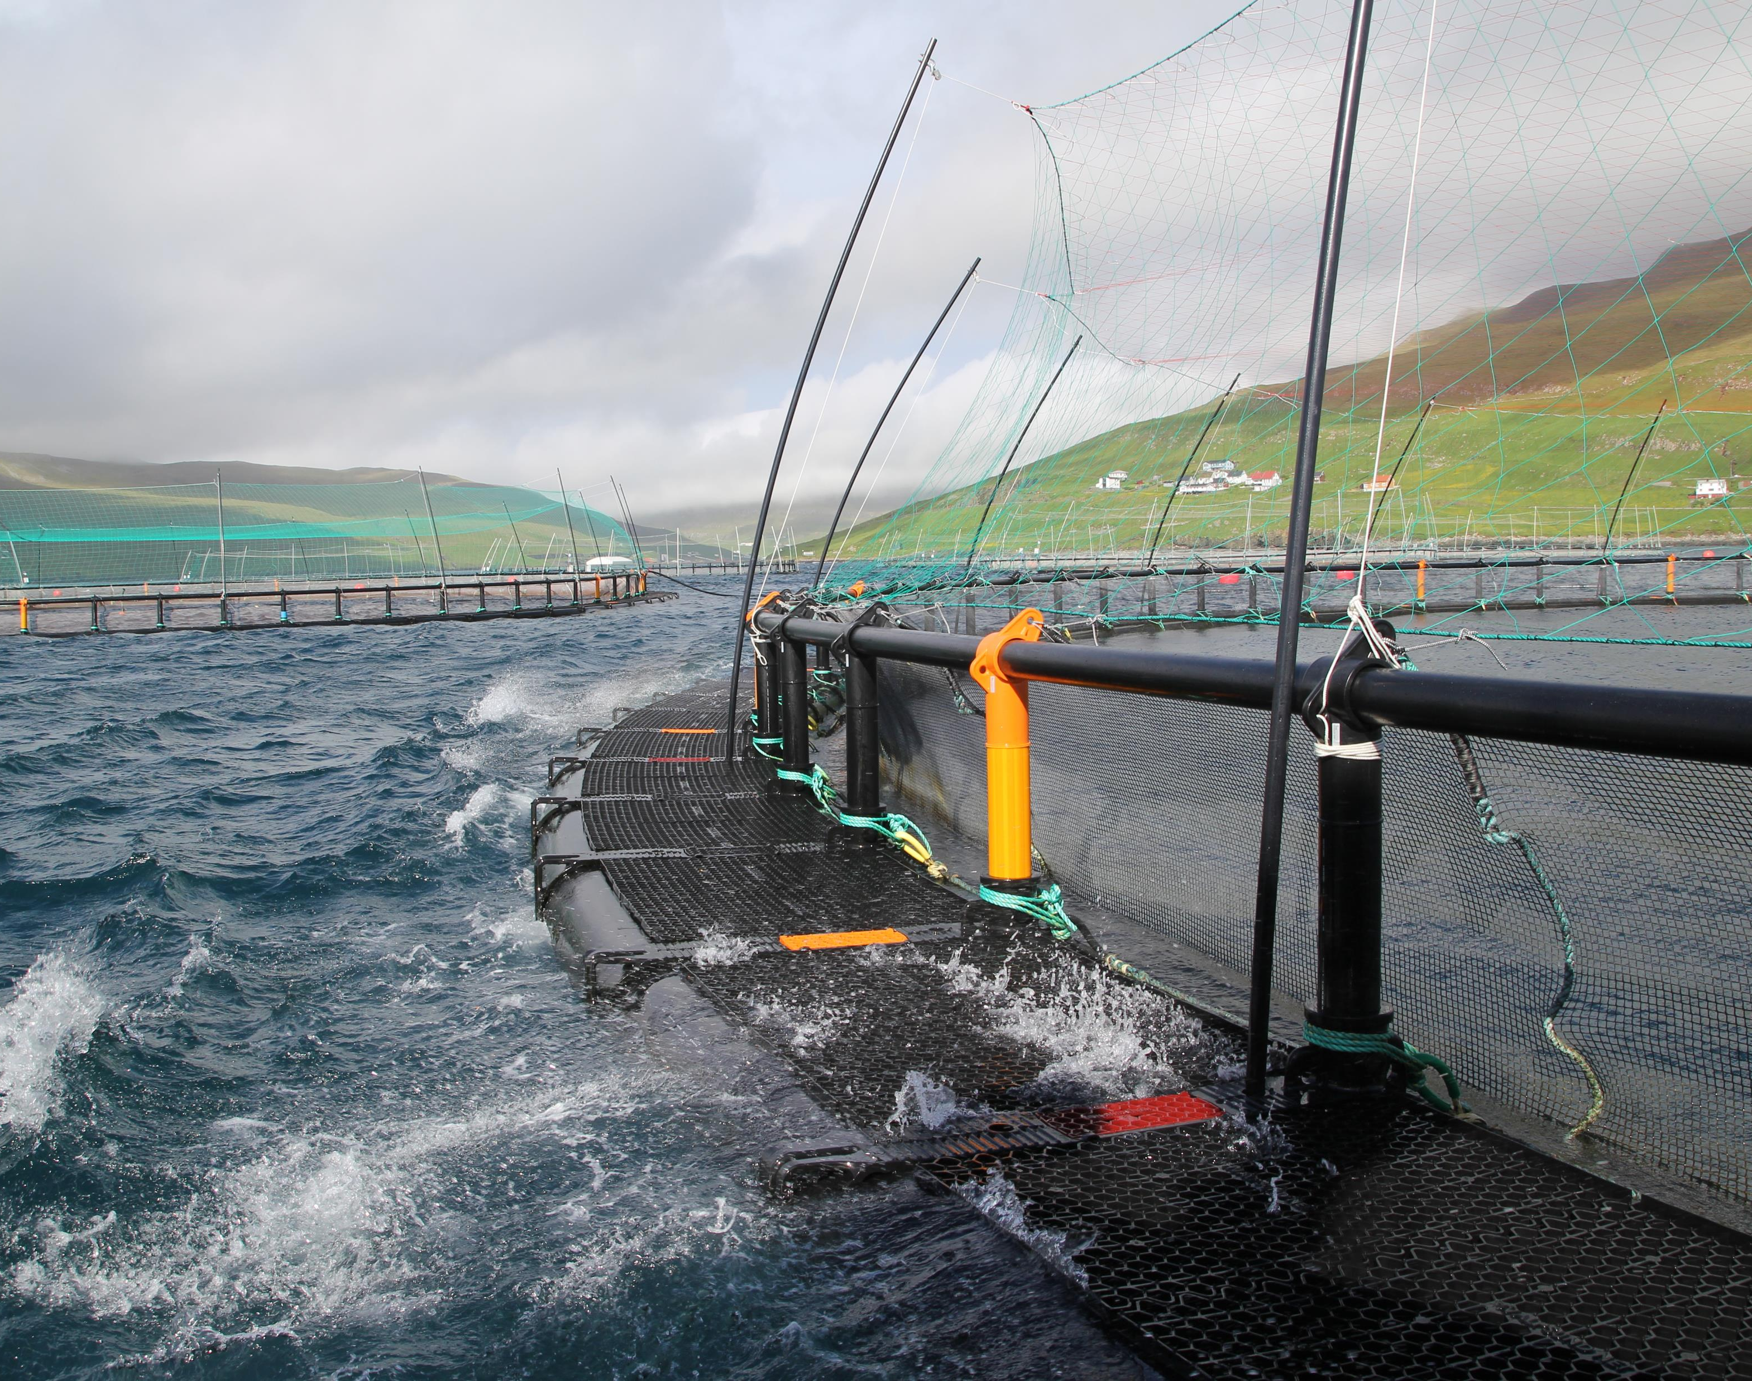
increasing the circularity of our PENS

Slide 7
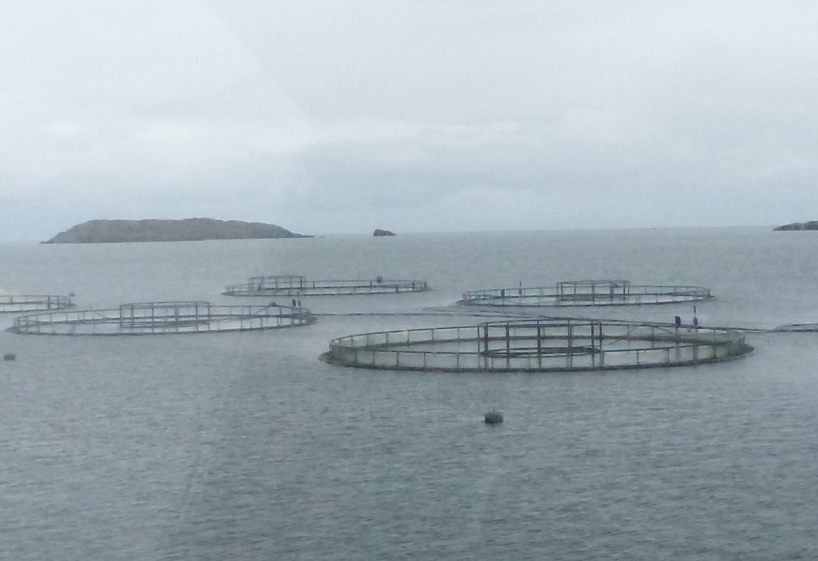
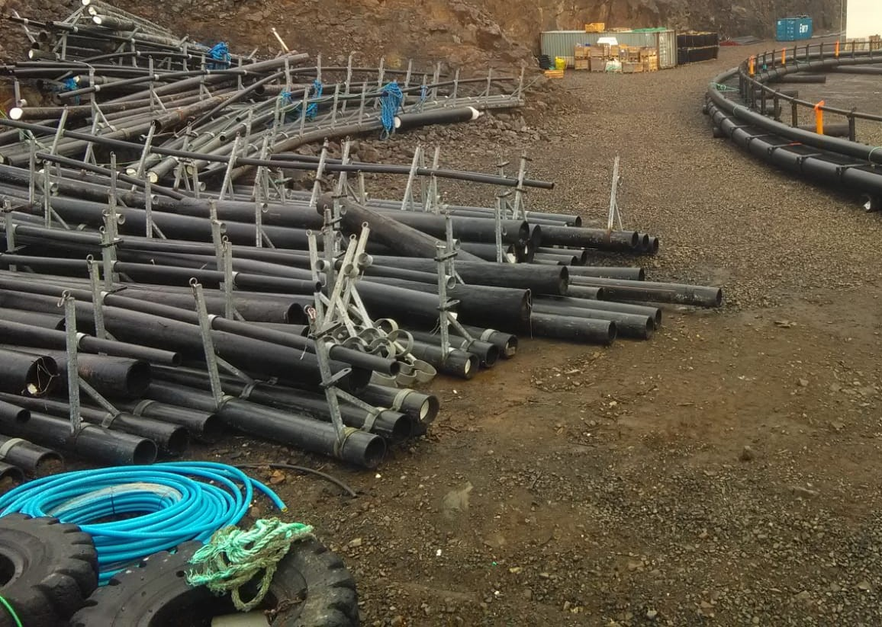
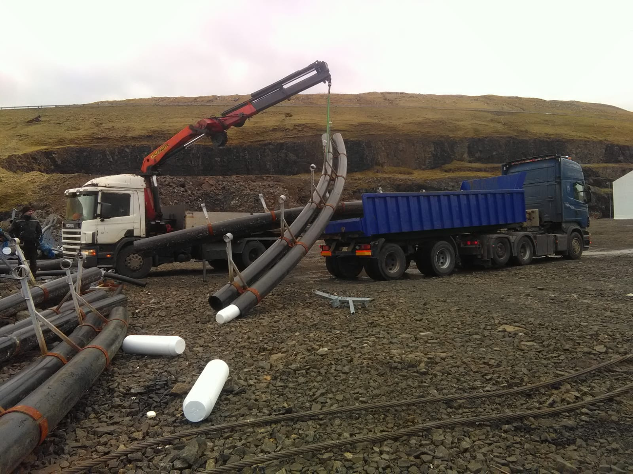
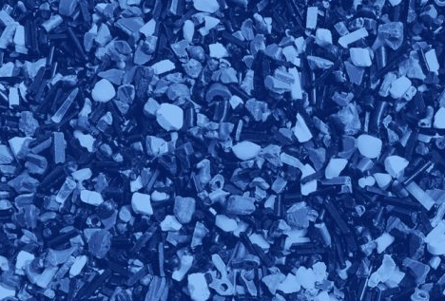
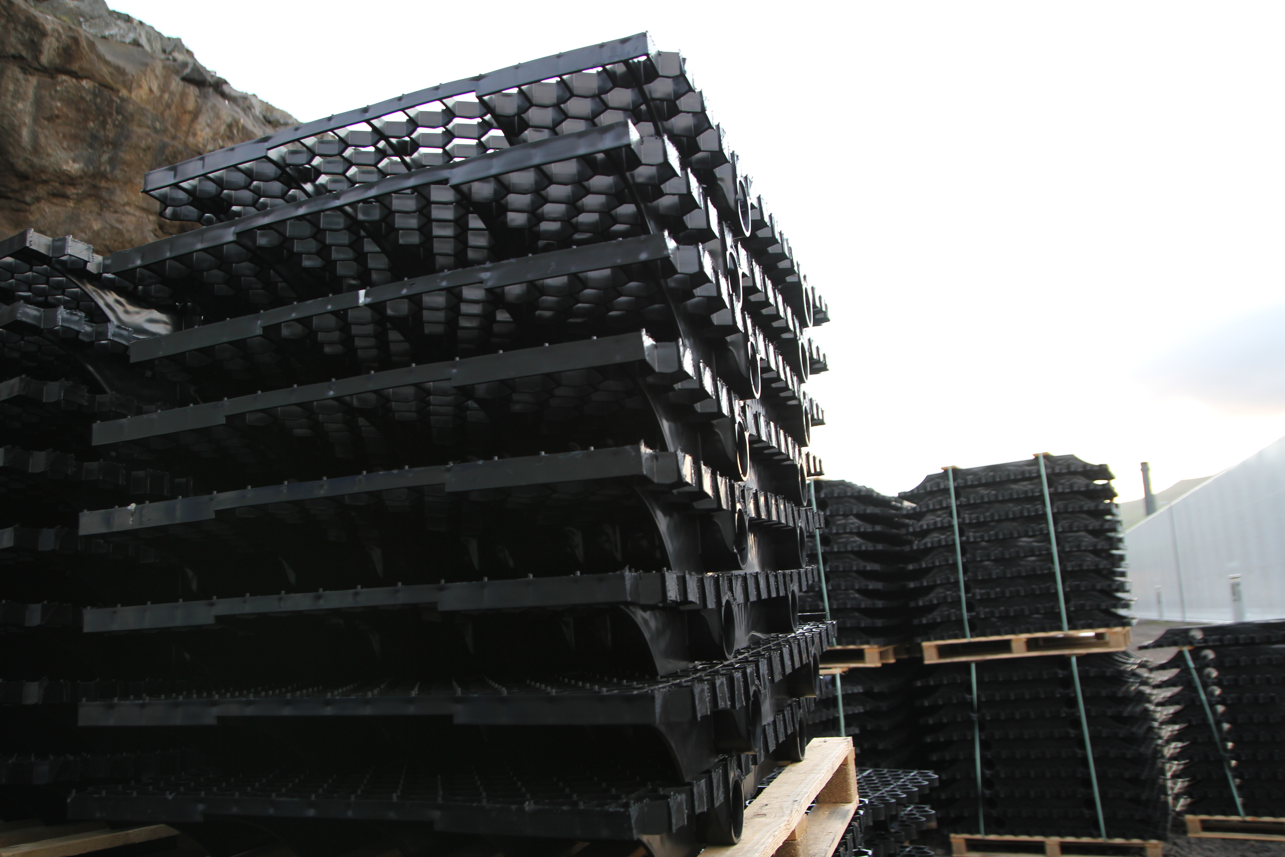
End of life 120m pen with hamster wheel
Cutting, separating, and washing on site
Logistic to recycle plant (HDPE only)
Washing, grinding, and pelletizing
Mixed in with new HDPE for production of non critical components.
Recycled HDPE back into the ocean
7

Slide 8
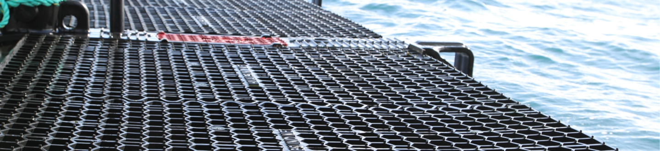
SOME Challenges
Logistics. A lot of the pens ready to be recycled in Norway today are located at remote locations along the Norwegian coast. This means the logistics for transportation of the used pens can be challenging.
Non-critical parts only. Today we are only able to use recycled plastic into non-critical parts of the pens.

Slide 9
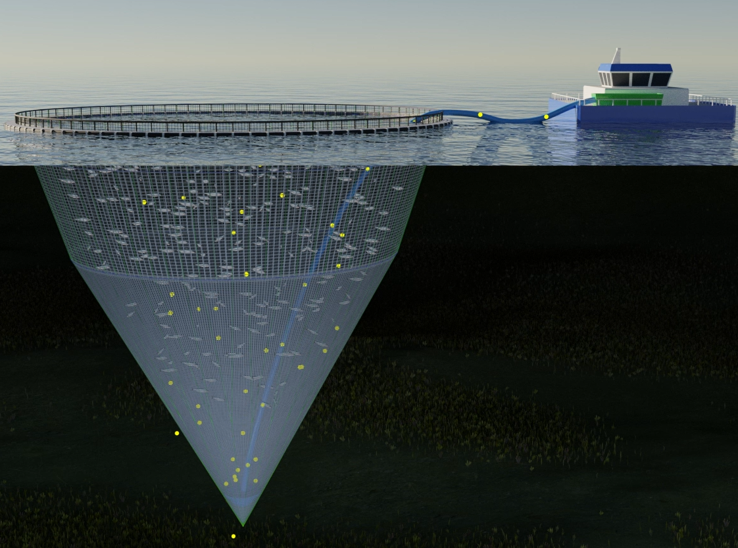
Mørenot
collect

Slide 10
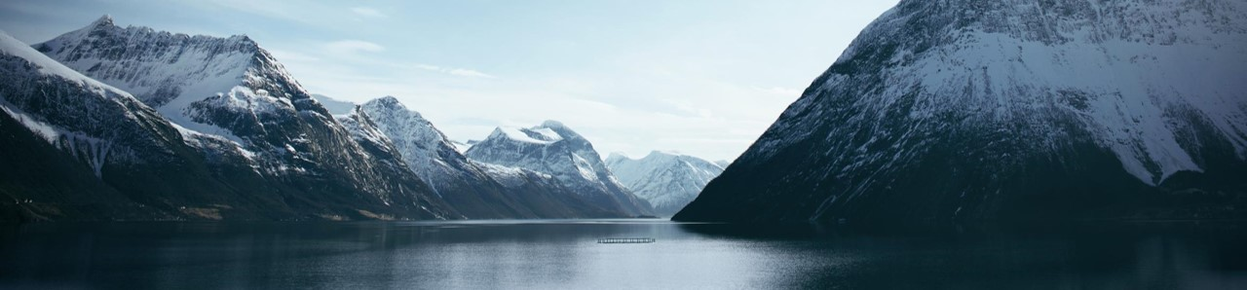
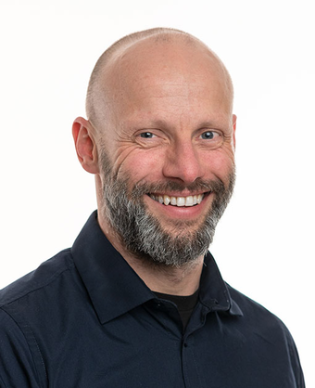

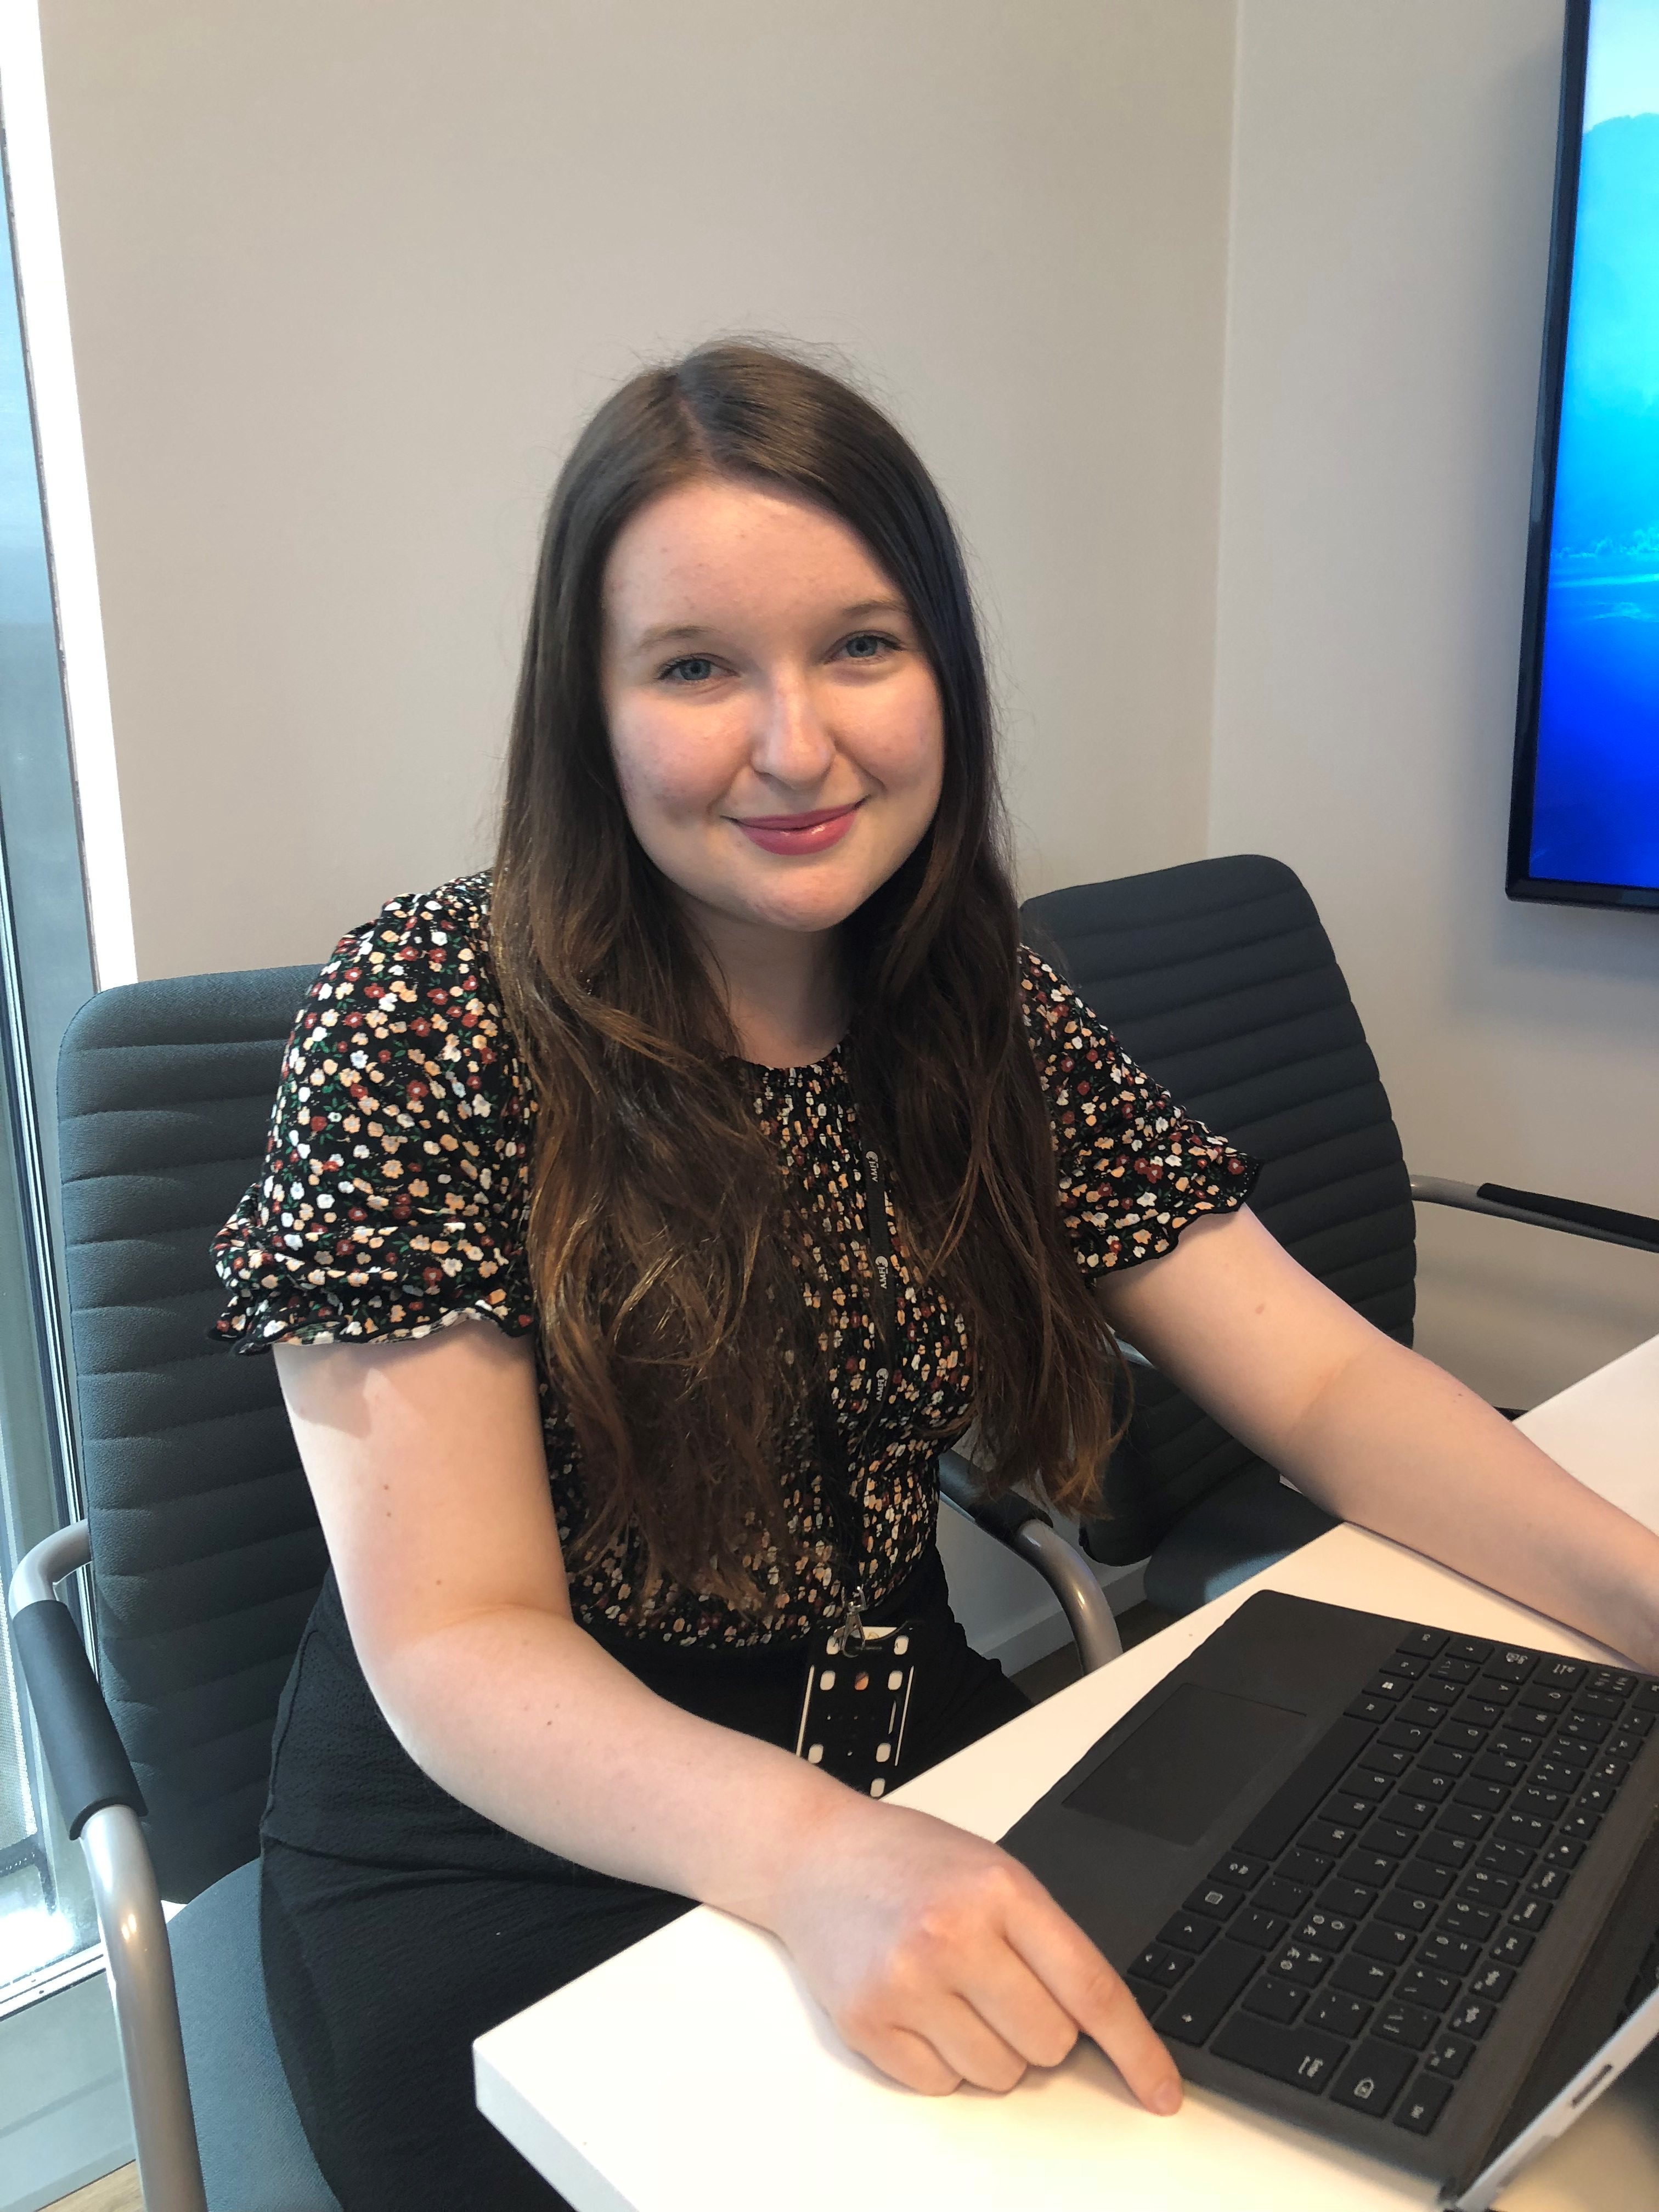
Contact information
Head of cages
Head of Sales,
Head of Mooring
Strategy and business development manager
Casper Guldberg Petersen
casper.petersen@morenot.com
Håvard Nybø
havard.nybo@morenot.com
Marthe Amundsen Brodahl
marthe.brodahl@morenot.com

